Slide 1
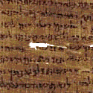
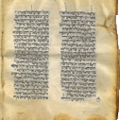
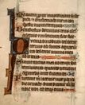
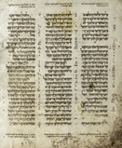
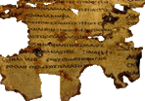
Hebrew Nash Papyrus
Greek Septuagint
Dead Sea Scrolls
Aramaic Targums
Latin Vulgate
Aleppo Codex
1000 BC
500 BC
1 AD
500 AD
1000 AD

Slide 2
Are you asking the BIG questions?
Am I reading my Bible correctly?
Is my Bible translated accurately?
Are Bible truths lost in translations?

