Slide 1
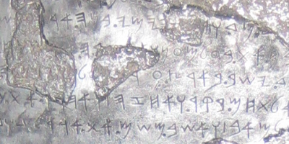

The Ancient
Hebrew Alphabet
Be an AHRC Sponsor
Advertise with us
Click Here

