Slide 1
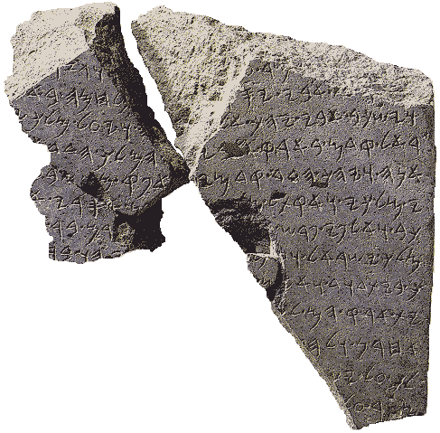


The Tel-Dan Inscription
9th Century BC
מלך ישראל
Melekh Yisra’el / King of Israel
בית דוד
Beyt David / House of David
Ancient Hebrew Research Center
www.ancient-hebrew.org

Slide 2
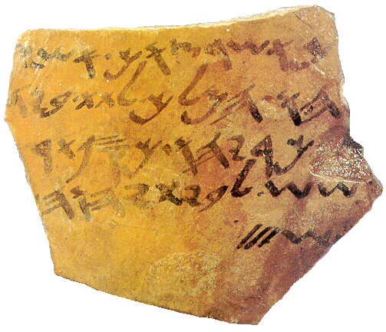
The Temple Ostracon
9th Century BC
Just as you commanded Ashyahu the king, to place in the hand of Zekaryahu, silver of tarshish, for the House of YHWH, 3 Shekels.
בית יהוה
House of YHWH
Ancient Hebrew Research Center www.ancient-hebrew.org

